Slide 1

Shell Scripting
BugSmashers

Slide 2
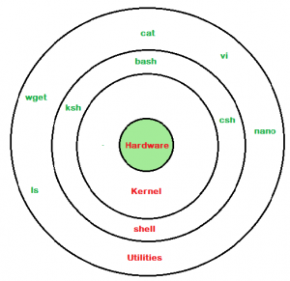

Layers of a Computer
Computers have many layers!
Hardware
Kernel
Shell
Utilities
When using the command line, you are giving instructions to the shell layer!

Slide 3
Many of these bash commands also exist as aliases in PowerShell*
Basic commands (revisited)
bash / zsh | PowerShell | Purpose
ls | dir | List contents in the current directory
cd | chdir | Change current directory to one specified
mkdir | md | Creates a new directory (folder)
pwd | pwd | Returns the path of your current directory
touch | New-Item | Creates an empty file
rm | rmdir | Removes a file
exit | exit | Exits the current terminal

Slide 4

Command Syntax (Revisited)
Each command should be written with
Command name
Parameters
Flags (and optional parameters)
Syntax looks like:
command [OPTIONS] arguments
Example of making a new folder in the current directory:
mkdir my_new_folder (unix)
md my_new_folder (windows)
If you forget, most commands have:
<command-name> --help

Slide 5


Writing your first bash/zsh script
Typically scripts for these files will end in .sh for bash and .zsh for zsh
Inside of your script, your first line is called the shebang, which is denoted as so:
#!/bin/bash or #!/bin/zsh
This is an absolute path to your shell interpreter so that your script knows which shell is required to run your program. In case your absolute path is different, you can run
which bash or which zsh
To find the location where bash or zsh are

Slide 6
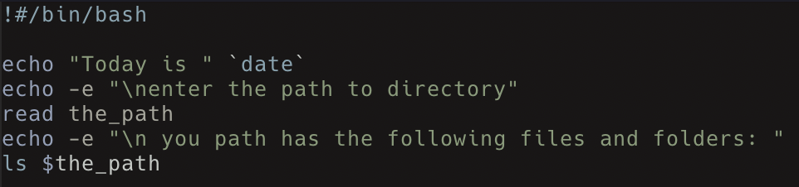
First script continued
The rest of the file can now be filled with bash/zsh commands that will be executed.
For example, take a look at the script below (first_script.sh):
Notes:
Explain what each part of the script does
Echo - prints out to the user
-e flag - allows interpretation of \ escapes (i.e \n \t)
read waits for user input and stores it into the_path variable
Then runs ls on the variable (notated by $) the_path

Slide 7
Running a script
To run a script, we first need to make it executable for the user. To do so, you must run the command below:
chmod +x first_script.sh
Once that is finished, you can run the script using any of the methods below:
sh first_script.sh
bash first_script.sh
./first_script.sh
Notes:
Explain each part again goofy ahh
chmod - change mode. Modifies permissions on a file (i.e read/write).
u - current user. Use chmod and u together to specify that the permissions are being changed for the current user.
+x - adds execution permission for the user

Slide 8
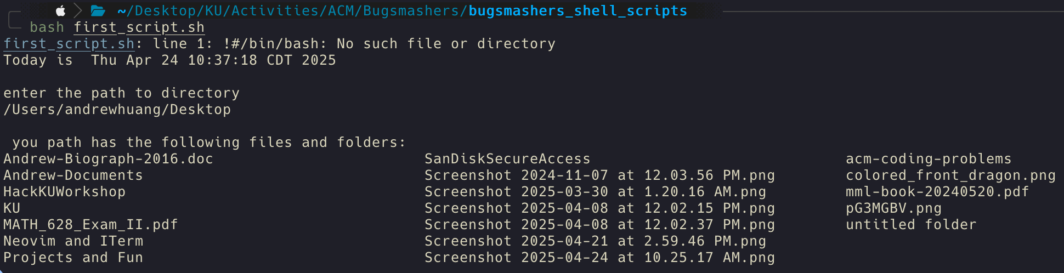
Output of script

Slide 9
shell scripts are like programming languages!
They can have loops, if statements, etc.
Code block example of an if statement:
if [ condition1 ]; then
# Code to execute if condition1 is true
elif [ condition2 ]; then
# Code to execute if condition1 is false and condition2 is true
else
# Code to execute if both condition1 and condition2 are false
fi
Loop examples:
For loops:
for item in list
do
commands
done
While loops:
while condition
do
commands
done

Slide 10
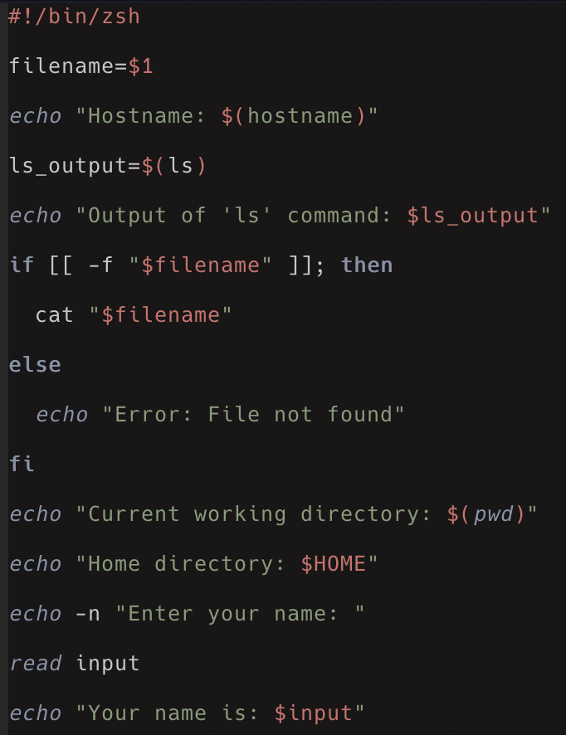
Second script example
The name of this file is second_script.zsh
The line filename = $1 takes in the first argument that written when running the script. For example, if the below line was run, “hello-world.txt” would be stored in the variable filename.
./second_script.zsh hello-world.txt
This is used later on in the if statement to check if the file exists in the current location, and to print its contents (if it exists).
Notes:
File explanation below (self explanatory stuff omitted):
prints hostname
creates subshell and runs ls in the subshell. Stores output into ls_output.
prints ls_output
checks if the file with filename exists, and if it does, then prints its contents
otherwise prints error
-n flag - do not print the newline that echo typically prints after a message.

Slide 11
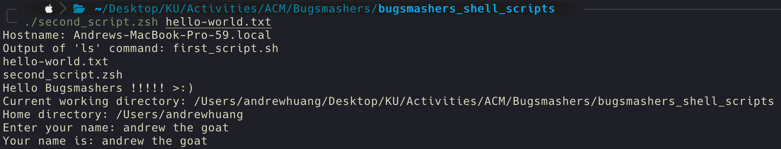
Output
Running the script should be similar to before, and output of this one should be close to as follows:

Slide 12

Demo/Live

Slide 13




Thanks!
Do you have any questions?
@SwordPoro - Andrew’s Discord
@jarsnow - John’s Discord
Ask for help in the ACM Discord!

